Slide 1




Excel
Training
for Beginners
SAID FAWZY
Manager of Information Center
Tendering Department
Arab Contractors

Slide 2


Excel
Training
for Beginners
SAID FAWZY
4
Formatting Data

Slide 3






90%
90%
1- Format Numbers
2- Date and Time Format
3- Cells, Rows and Columns Formatting
4- Format Painter
Exam 4: Formatting Data

Slide 4
Excel
Training
for Beginners
SAID FAWZY
Format Numbers
1

Slide 5
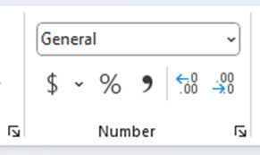
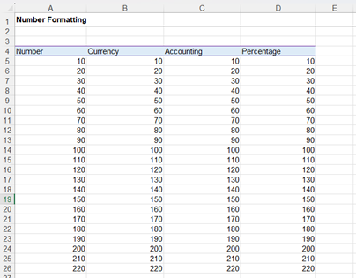
Format Numbers
General

Slide 6

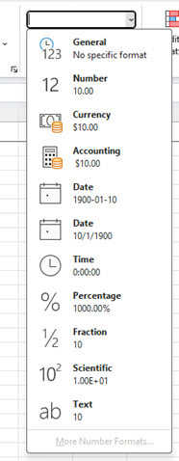
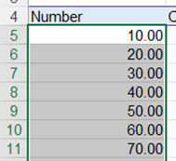
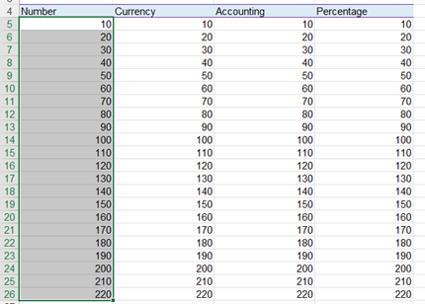

Format Numbers
Number

Slide 7
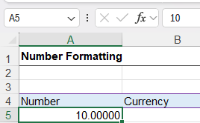

Format Numbers
Number

Slide 8

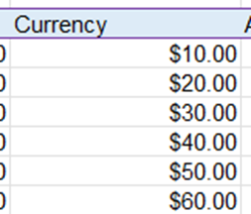
Format Numbers
Currency

Slide 9
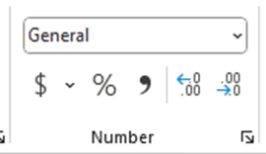


Format Numbers
Currency
Change the Currency Symbol
2
1

Slide 10
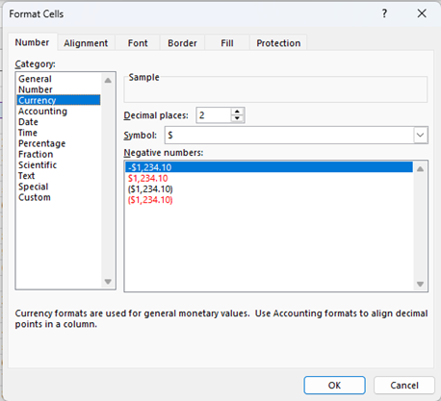
Format Numbers
Currency
Change the Currency Symbol
2
1

Slide 11

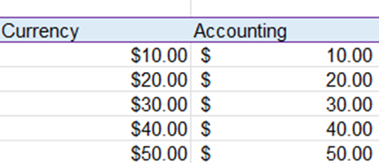
Format Numbers
Accounting Format

Slide 12
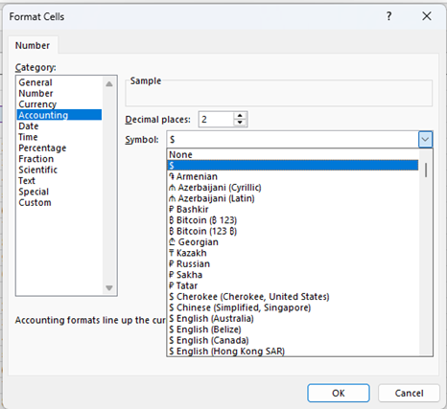
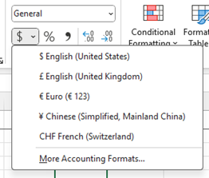
Format Numbers
Accounting more options

Slide 13


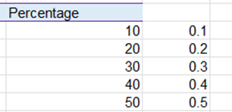
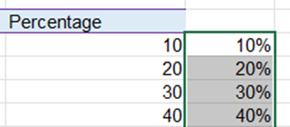
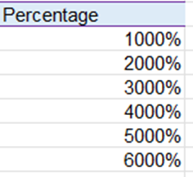
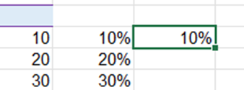
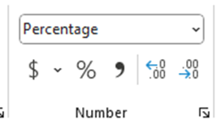
Format Numbers
Percentage

Slide 14



Format Numbers
Comma Style

Slide 15
Excel
Training
for Beginners
SAID FAWZY
2
Date and Time Format

Slide 16
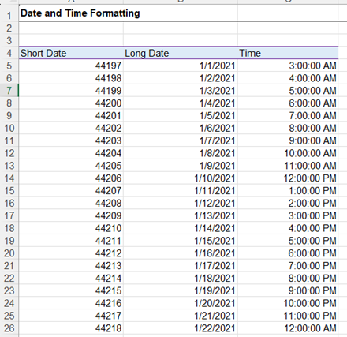
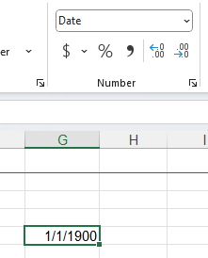
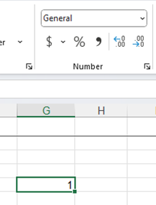
Date and Time Format
Date and Time Format

Slide 17

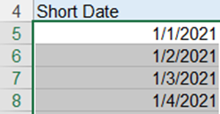
Date and Time Format
Date Format

Slide 18


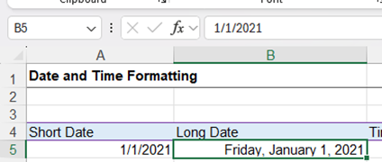
Date and Time Format
Date Format

Slide 19
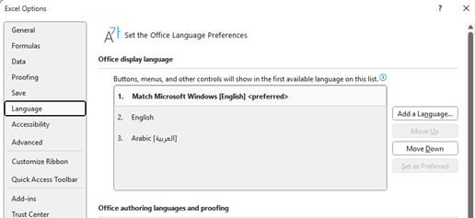
Date and Time Format
Change Date Format

Slide 20
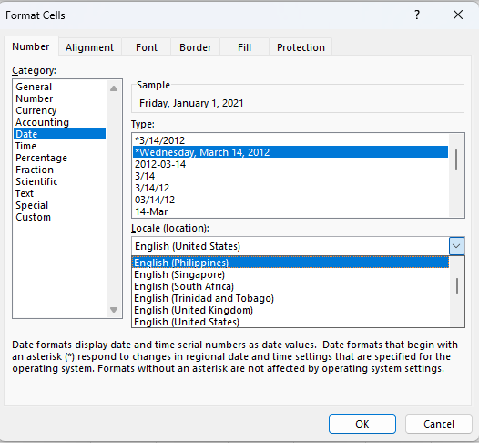
Date and Time Format
Change Date Format

Slide 21
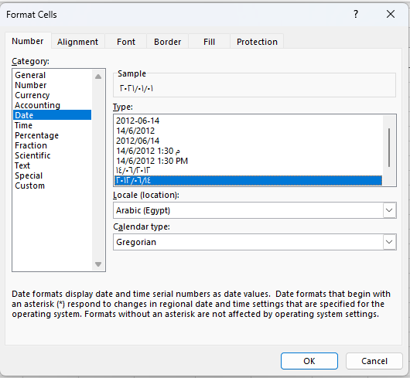
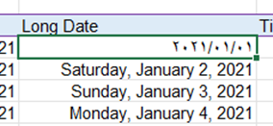
Date and Time Format
Change Date Format

Slide 22
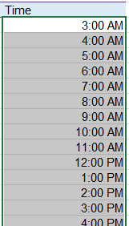
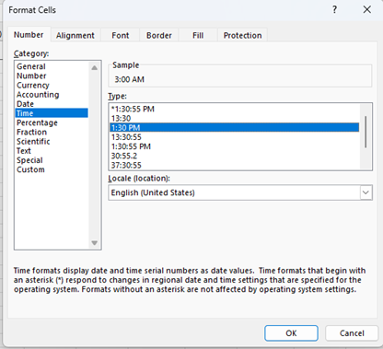
Date and Time Format
Time Formatting

Slide 23
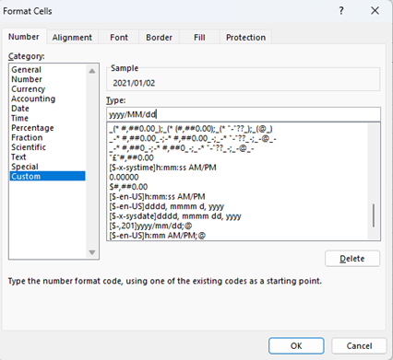
Date and Time Format
Custom Format

Slide 24
Excel
Training
for Beginners
SAID FAWZY
Cells, Rows and Columns Formatting
3

Slide 25
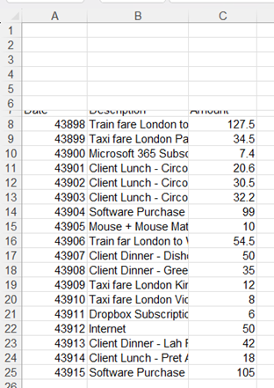
Cells, Rows and Columns Formatting
Rows Formatting

Slide 26
Cells, Rows and Columns Formatting
Invoke AutoFit Row Height

Slide 27
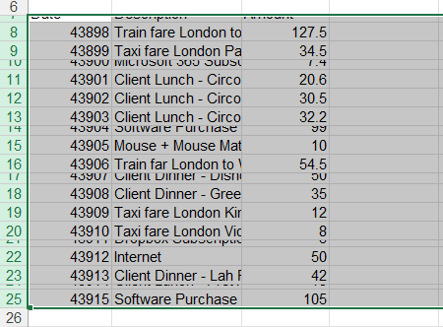
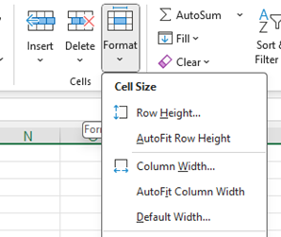
Cells, Rows and Columns Formatting
Invoke AutoFit Row Height

Slide 28
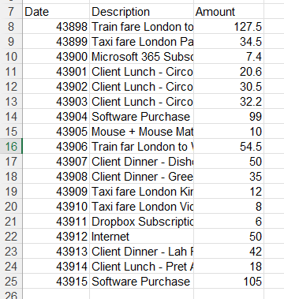
Cells, Rows and Columns Formatting
Invoke AutoFit Row Height

Slide 29
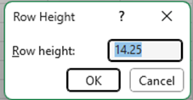
Cells, Rows and Columns Formatting
Rows Height

Slide 30
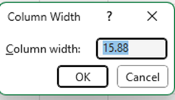
Cells, Rows and Columns Formatting
Column Width

Slide 31

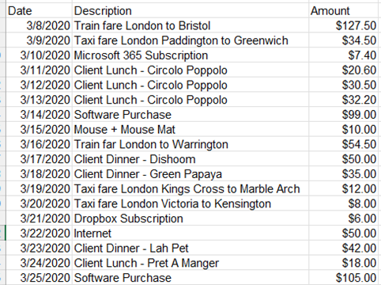
Cells, Rows and Columns Formatting
Format the Data

Slide 32
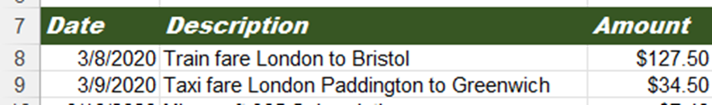
Cells, Rows and Columns Formatting
Change The Font

Slide 33
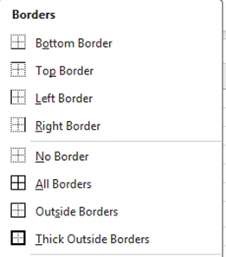
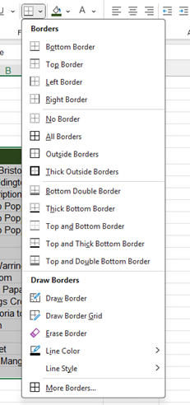
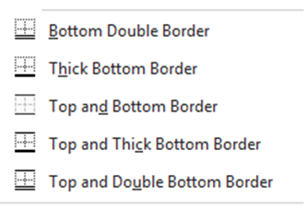
Cells, Rows and Columns Formatting
Adding Boarders

Slide 34
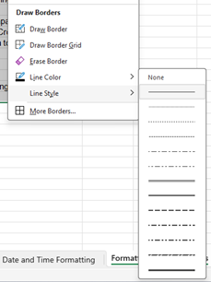
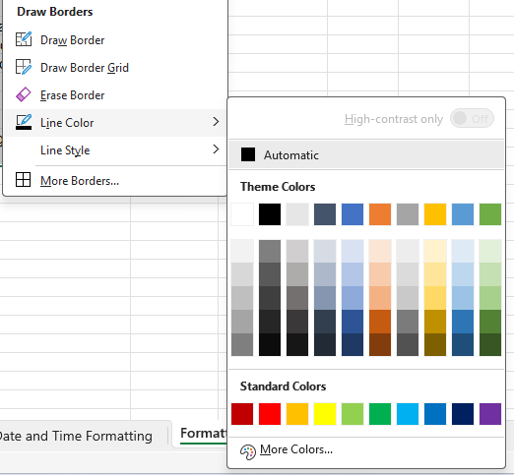
Cells, Rows and Columns Formatting
Adding Boarders

Slide 35
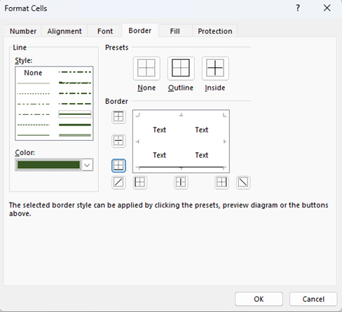
Cells, Rows and Columns Formatting
Boarder Tab Options

Slide 36
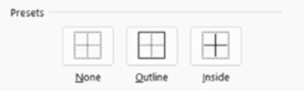
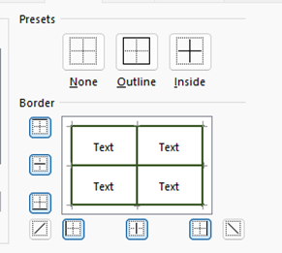
Cells, Rows and Columns Formatting
Boarder Tab Options

Slide 37
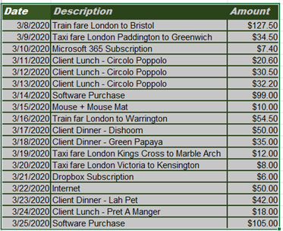
Cells, Rows and Columns Formatting
Boarder Tab Options

Slide 38
Excel
Training
for Beginners
SAID FAWZY
4
Format Painter

Slide 39
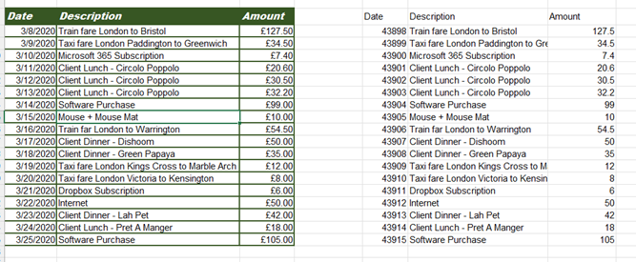
Format Painter
Format Painter

Slide 40
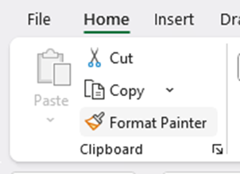
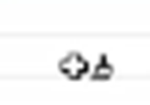

Format Painter
Format Painter

Slide 41
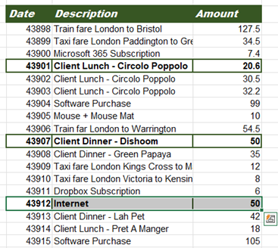

Format Painter
Format Painter

Slide 42

Format Painter
Format Painter

Slide 43

Format Painter
Format Painter

Slide 44
Excel
Training
for Beginners
SAID FAWZY
Exam 4
Formatting Data

Slide 45

Exam 4: Formatting Data

Slide 46

Exam 4: Formatting Data

Slide 47

Exam 4: Formatting Data

Slide 48

Exam 4: Formatting Data

Slide 49

Exam 4: Formatting Data

Slide 50



